Slide 1
Cultural Heritage, Copyright and Code:
Europeana Space as a case study
Professor Charlotte Waelde
University of Exeter

Slide 2
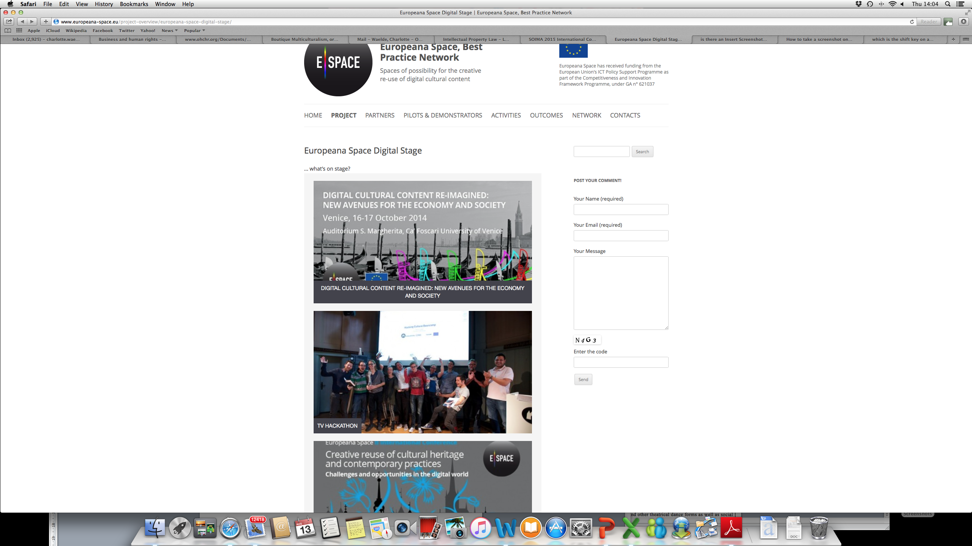
The Europeana Space Project

Slide 3
The Europeana Space Project
Three Spaces
Technical Space: a framework for storing, accessing and processing cultural heritage content and metadata.
Content Space: guidelines and tools for clearing copyright information about the development of business models for the exploitation of digital cultural heritage content.
Innovation Space: an environment for the enhancement and exploitation of content, applications and services, which stimulates creative entrepreneurship and gives support to creative enterprises (particularly SMEs).

Slide 4
The Europeana Space Project
Six pilots: Photography; Europeana TV; Dance; Open and Hybrid Publishing; Museums; Games
Hackathons
Business Modeling workshop
Incubation
IPR relevant at each stage – existing and new

Slide 5
The Europeana Space Project
Finding content
Finding content where IPR ownership and permitted use is clear
Finding owners when (more) permissions sought
Managing existing and new IPR during the course of the project

Slide 6
The Europeana Space Project
Identification of rights holders
Extent of permissions to re-use
Authenticity and integrity (moral rights)
Data on how cultural heritage is used and re-used (and monetised) in the cultural economy
Facilitate (collective) licensing?

Slide 7
The Europeana Space Project
Regional coding? Single copies?
Exceptions and limitations – nuanced interpretation – Trusted Third Party? (WIPO Treaty on exceptions and limitations for visually impaired)
Berne Convention rule on ‘no formalities’ (Article 5)
Privacy: private information carried by images; privacy of person using images?

